Slide 1

Employees Attrition Trends or Patterns

Slide 2


Introduction
Unlock the secrets of employee attrition through comprehensive analysis. Discover underlying trends, drivers, and implications to inform proactive retention strategies and foster a thriving workplace culture.

Slide 3
Analysis
Attrition Rate
Attrition
Department Wise
Attrition by Income
Attrition by Age
Attrition by Salary Hike
Attrition by Distance
Attrition by Job Satisfaction

Slide 4
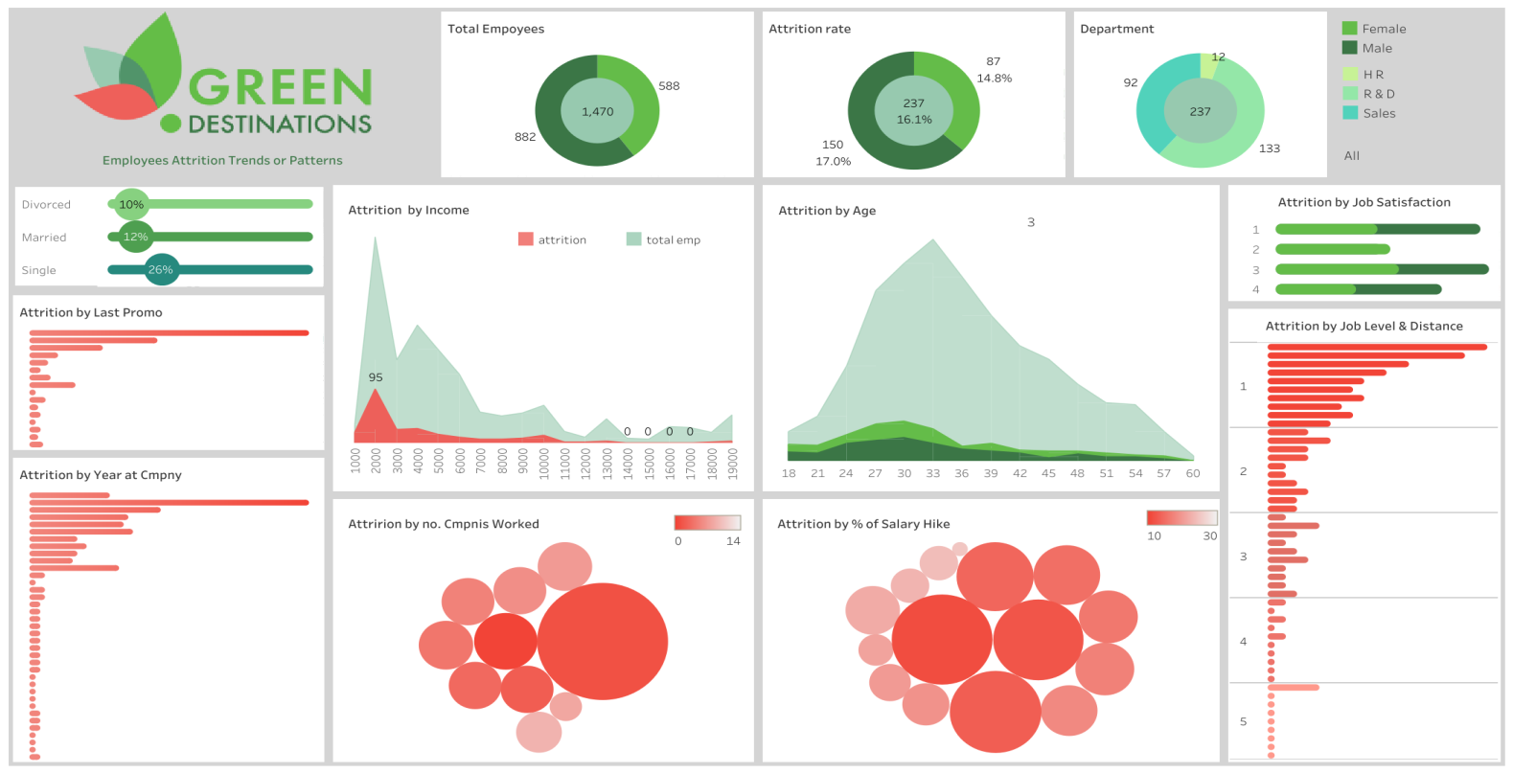
Dashboard

Slide 5
Thank you

